Slide 1
30KW DC Charger FW Implementation CES SG Understanding & Queries for Clarification/Support 16th Oct 2019

Slide 2
Understanding on Primary MCU
FW Implementation

Slide 3


Primary MCU - Control Block Diagram
Interleaved Vienna Rectifier
Input Voltage, Current Sensing
PFC_OUT
INLET
EMI
RELAY
Vienna
Rectifier
PFC Output Voltage Sensing
800V DC Output
Vienna
Rectifier
Relay
Drive
PFC_NEG
PWM Driver
Input V & I Analog Sensing
6 Channels
2 Channels Per Phase
VA, IA, VB, IB, VC & IC
Relay PWM
AH
BH
CH
AL
BL
CL
VPFC_OUT
HW OCP
PWM Outputs
TI
TMS320F28069
VPFC_MID
Phase C
TZ
Analog IN
VPFC_OUT OVP
Zero Crossing Detector Digital Input - 3
Phase B
Analog IN
VPFC_MID OVP
Phase A
TZ
HW VBC OVP
Auxiliary Supply –(to Pri. Drive Circuits)
Control PWM (Open Loop)
ZCD A, B, C
(ECAP)
PWM Outputs
BS_PWM
DI
ORPS PWM
Secondary Auxiliary
Supply (Open Loop)
Additional Analog Sensing
Total 12 Channels
VBIAS – 1 Ch
NTC Thermistor – 11 Ch
(Out of 11, 3 Channels are connected Directly and 8 Channels are connected through an Analog Mux).
DI
PFC_EN
Analog IN
AC_OFF
ISO7241CDW
To/From Secondary MCU
Mux Sel. 1-3
DO
PFC_OK
DO
I2C Master
UART
Isolator
TX
RX
ISO7241CDW
PWM Output
CLOCK
DATA
Analog Input
I2C EEPROM 24LC04B
Isolator
Digital Input
Digital Output
COM (I2C/UART/SPI/CAN)
For Calibration Data
TZ Input

Slide 4
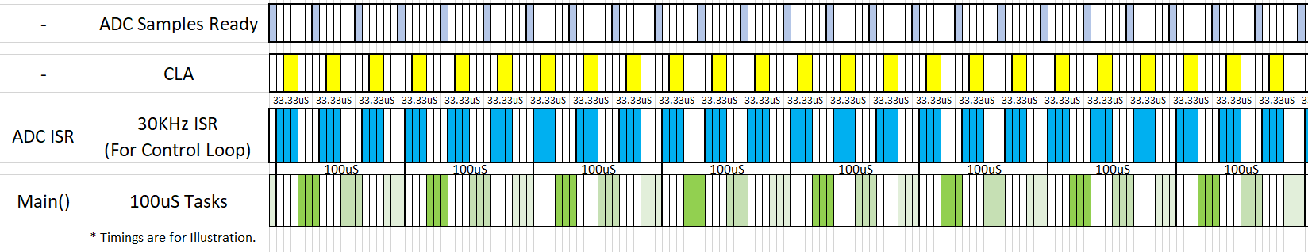
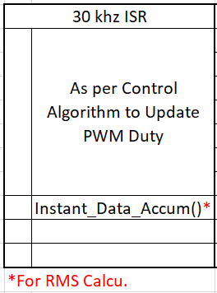
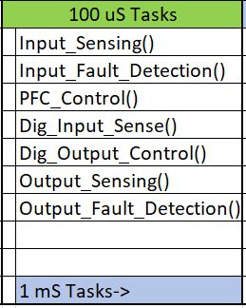
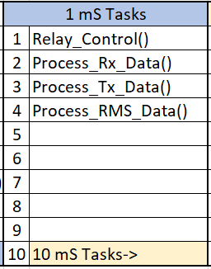
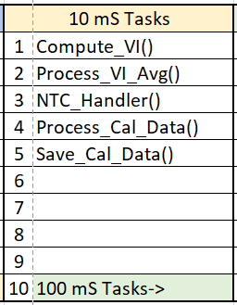
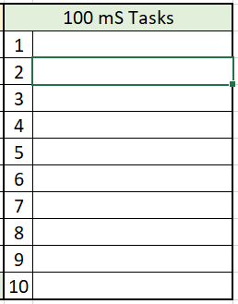





Primary MCU – Task handler timing plan
ISR
Main() Tasks

Slide 5
Primary MCU – Peripheral Config. & Logics
Digital Inputs:
PFC_EN
Purpose – To Control “Turn ON” and “Turn OFF” of PFC PWM.
Logic – High -> Enable PFC PWM and enter to SS Loop
Low -> Disable PFC PWM.
Delay to Enable /Disable PWM after detection - To be defined
Zero Crossing Detectors – ZCDA, ZCDB and ZCDC – Not Used Currently (Future backup)
Purpose – To Detect & generate interrupt during input voltage Zero Crossing.
To Compute Frequency, Phase Sequence PLL for SVPWM Synchronization
Logic – Used with Edge Triggered Enhanced Capture Input to trigger interrupt.
Digital Output:
AC_OFF
Purpose – To notify secondary MCU on the status of Input. Just to display on GUI.
Logic – High -> AC I/P is available and within valid range btw all phases
Low -> AC I/P is OFF or phase Unbalance detected or I/P out of range.
Delay/Thresholds to detect AC OK/Fail are to be defined.
PFC OK
Purpose – To notify secondary MCU on the status of PFC Output to TURN OFF D2D.
Logic – High -> PFC Output is within valid range.
Low -> PFC Output is out of range or OVP triggered(*).
Delay/Thresholds to Detect PFC OK/Fail are to be defined.

Slide 6
Primary MCU – Peripheral Config. & Logics
Analog Inputs:

Slide 7
Primary MCU – Peripheral Config. & Logics
Analog Inputs:
Analog Inputs – For Control Loop
VCSA, VCSB, VCSC – 2.44V @ 442Vpk Input V with zero Cross @ 1.65V
- With Max Sensing @ 1035Vpk @ 3.3V
ICSA, ICSB, ICSC – 2.692V @ 72.5Apk Input I with zero Cross @ 1.65V
- With Max Sensing @ 100Apk @ 3.087V
PFC_VOUT – 2.889V @ 800V, 3.070V @ 850V
PFC_VMID – 2.573V @ 400V, 2.894V @ 450V
Analog Inputs – For V,I RMS Calculation
Same signals (as in control Loop) are used for VI calculation also.
Analog Input – VBIAS
Purpose – Detection of Voltage source for SB1 (for ref Calibration / Tuning of ADC)
Analog Input – 11 NTC Thermistor – Temperature sensing
Thermistor used – TSM2A103F34D1RZ , B25/85 Beta Value - 3435
3 Channels are connected directly to MCU
and 8 Channels are connected through 8 by 1 Analog Mux.
Analog Input – For Output OVP Protection - SW
PFC_OVP, PFC_MID_OVP – 10-20mS to Shutdown. Recovery response to be defined.

Slide 8
Primary MCU – Peripheral Config. & Logics
Communications:
UART:
Baud rate – 115200 bps
Data’s to Share to Secondary MCU :
Phase Voltages – VA, VB, VC
Phase Current – IA, IB, IC
Real Phase Power – PA, PB, PC
Bulk Voltage – VPFC, VMID
Line Frequency – ?
Debug Data’s – to be defined
Data’s to Receive:
Calibration Data’s
Commands for Configuration/Setup.
Debug Commands
Either data packets can be auto transmitted periodically or Transmitted based on the request from secondary/host.
I2C Master: (For Calibration Data Read/Write Access to I2C EEPROM
Clock Frequency – 100 khz
I2C Slave Address – 0xA0 (1st 256x8bit), 0xA2 (2nd 256x8bit),
Data’s to Save to EEPROM:
Input Voltage, Current & Power Calibration Data’s (TBD).

Slide 9
Primary MCU – Peripheral Config. & Logics
PWM Trip Zone(TZ) Inputs – For Protection:
PFC_TZ
HW OCP @ 160Apk I/P Current. – Cycle by Cycle Current limit (Trip PWM)
VBC_OVP
HW OVP for Bulk @ 890V PFC_OUT – Shutdown PFC. and recovery to be defined.
PWM Outputs:
Relay PWM: (H)
Config – Independent PWM Mode
Frequency – 30KHz
ON/OFF Logic – Turn ON/OFF input threshold/delays to be defined.
BS_PWM (Open Loop): (H & L)
Config – Complementary PWM Mode
Frequency – 100KHz
Duty % - 50% Duty
ON/OFF Logic – ON after MCU startup (with some delay).
ORPS_PWM (Open Loop): (H & L)
Config – Complementary PWM Mode
Frequency – 100KHz
Duty % - 50% Duty
ON/OFF Logic – ON after MCU startup (with some delay).

Slide 10
Primary MCU – Peripheral Config. & Logics
PWM Outputs:
DRAH, DRBH, DRCH, DRAL, DRBL, DRCL : (Closed Loop Control)
Config – 6 Independent PWM Channels from 3 Pairs of PWM
to Control Interleaved Vienna Rectifier (3 PWM’s for each Vienna rectifier)
Frequency - 30khz
Control algorithm - Space Vector PWM (SVPWM)
**To be defined/studied for understanding and implementation.
Compensator Type – Normal PI
Protections (PWM Trip Zone) – I/P Current OCP @ 160Apk (Trip Cycle by Cycle )
PFC_VOUT OVP @ 890V (Trip and Latch , Recover once recovery threshold reached ??)
Interrupts:
ADC Interrupt – 30KHz, High Priority, For Main Control Loop
PWM Trip Zone Interrupt – High Priority.
ECAP Interrupt – (Reserved) Medium Priority, to detect & Process Voltage Zero Crossing
UART RX and TX Interrupts – Medium Priority , Minimal execution time.
Other Timer Interrupt – 100uS (for Main Task Handler), Low Priority
I2C Master Interrupt – Low priority, called only during startup, Loading EEPROM data and during saving calibration data.

Slide 11
Understanding on Secondary MCU
FW Implementation

Slide 12
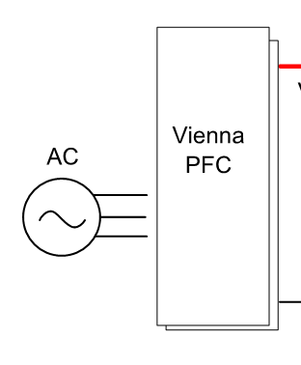

Secondary MCU - Control Block Diagram
LLC 1 & LLC 2
Buck 1 & 2
HVDC+
BAT+
+800V
LLC1
550V
BUCK 1
IBCK12
3 Ph AC I/P ~323-553Vac
HVDC V & I Sense
EMI & Oring
VBAT Sense
LLC2
550V
BUCK 2
HVDC-
BAT-
LLC 3 & LLC 4
Buck 3 & 4
LLC3
550V
BUCK 3
IBCK34
IHVDC
VHVDC
IBUCK12
VHVDC
VBAT_SEN
-800V
LLC4
550V
BUCK 4
IBUCK34
ILLC1
ILLC2
VLLC1
VLLC2
VBUCK1
VBUCK2
VBUCK3
VLLC3
VLLC4
VBUCK4
ILLC3
ILLC4
LLC & BUCK V & I Sensing
VLLC1 to 4 - 4 Channels
VBUCK1 & 3 - 2 Channels
IBUCK1 & 3 - 2 Channels
V&I HVDC – 2 Channels
VBAT Sense – 1 Channel
8A/B
6A/B
1A/B
7A/B
3A/B
2A/B
PWM DRIVER
Additional Analog Sensing
Total 12 Channels
VAUX – 1 Ch
NTC Thermistor – 11 Ch
(Out of 11, 3 Channels are connected Directly and 8 Channels are connected through an Analog Mux).
ILLC1-4
PWM Outputs
LLC OCP
OVP/OCP/ SCP
TI
TMS320F28069
BUCK OVP
VBUCK1-4
Analog IN
TZ Inputs
HVDC OCP
IHVDC
Discharge EN
To VOUT Discharge Control
Mux Sel. 1-3
DO
DO
DI’s
6 Bit Address
CAN Addr. Selection
From Dip Switch
PFC EN
DO
DI
D2D EN
AC OK & PFC OK
DI
TX
To/From System
Output
Connector
RX
PWM
Output
CAN
CAN Bus Driver
UART
RX
TX
I2C Master
DO
DI
PWM Output
To/From Primary MCU
4A
3 FAN Speed Inputs
Analog Input
CLOCK
DATA
Digital Input
FAN DRIVER
To FAN
Digital Output
I2C EEPROM M24256-BWDW6TP
3 LED
Control Pins
COM (I2C/UART/SPI/CAN)
LED DRIVER
TZ Input
For Calibration/
Config Data
To LED’s

Slide 13
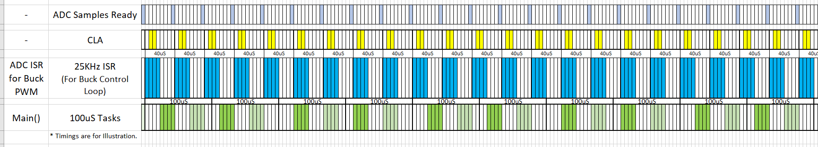
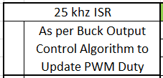
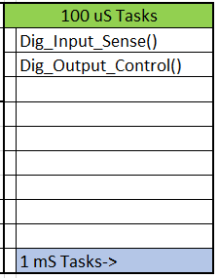
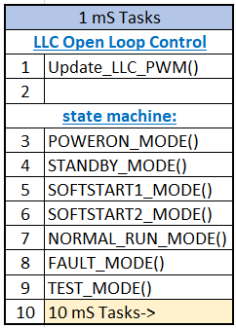
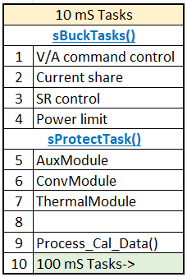
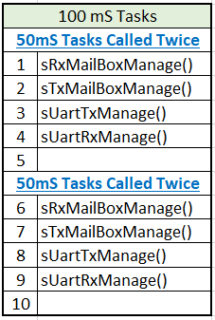

Secondary MCU – Task handler timing plan
ISR
Main() Tasks

Slide 14
Secondary MCU – Peripheral Config. & Logics
Digital Inputs:
D2D_EN
Purpose – To Control Charging “Enable/Disable” and “Turn ON/OFF” of D2D.
Logic – Low -> Enable Charger and D2D Conversion
High-> Disable Charger and D2D Conversion.
Delay to Enable & Disable Charger, after signal detection - To be defined
AC_OK and PFC_OK from Primary MCU:
Purpose – To Notify the secondary MCU on the status of AC Input and PFC Boost Status to Enable/Disable the DC to DC Conversion.
AC_OK Logic – High -> AC I/P is available and within valid range btw all phases
Low -> AC I/P is OFF or phase Unbalance detected or I/P out of range.
PFC_OK Logic – High -> PFC Output is within valid range.
Low -> PFC Output is out of range or OVP triggered(*).
CAN Address Selection Inputs:
Purpose – To Fix the CAN Bus Address during initialization for its communication.
Address Range – 6 Bits – 64 Address Combination.
Hex Address Range – 0x01 to 0x04.
Hex Address 0x00 is for Special Applications.

Slide 15
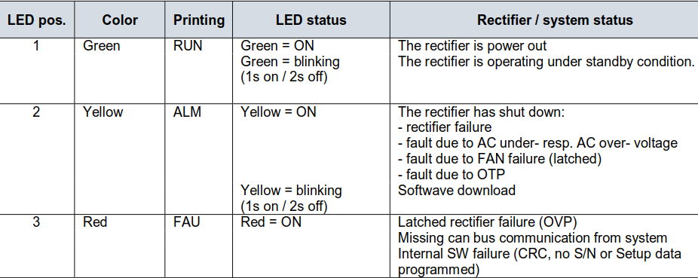
Secondary MCU – Peripheral Config. & Logics
Digital Output:
PFC_EN
Purpose – To notify Primary MCU to Enable/Disable PFC, based on the Status of the D2D_EN pin.
Logic – High -> Enable PFC PWM and enter to SS Loop
Low -> Disable PFC PWM.
Delay to Enable /Disable PWM after detection - To be defined.
VOUT_Discharge
Purpose – To Discharge the O/P Voltage at the terminals as soon as the charger
shutdown the output (for safety reason).
Logic – After Output Shutdown Enable(High) this pin for predetermined time to discharge the O/P voltage & disable it afterwards before the next output
turn ON.
LED Control

Slide 16
Secondary MCU – Peripheral Config. & Logics
Analog Inputs:
Analog Inputs – For Buck Converter Closed Control Loop
VBuck1 & VBuck3 – 2.53V @ 500V Output
- VBuck = VBuck_ADV / 0.00506
IBuck1 & IBuck3 – 3.005V @ 74.8A O/P I
- IBuck = IBuck_ADV / 0.04018
VHVDC – 2.505V @ 1000V Output
- VHVDC = VHVDC_ADV / 0.002505
IHVDC – 2.1432V @ 80A O/P I
- IHVDC = IHVDC_ADV / 0.026787
VBAT_SEN – 2.505V @ 1000V Output
- VBAT_SEN = VBAT_SEN_ADV / 0.002505
Analog Inputs – For LLC Open Loop
VLLC1 to VLLC4 – 2.489V @ 550V Output
- VLLC = VLLC_ADV / 0.004525
Analog Input – Vaux
Purpose – Detection of Voltage source for SB1 (for ref Calibration / Tuning of ADC)
Analog Input – 11 NTC Thermistor – Temperature sensing
Thermistor used – TSM2A103F34D1RZ , B25/85 Beta Value - 3435
3 Channels are connected directly to MCU
and 8 Channels are connected through 8 by 1 Analog Mux.

Slide 17
Secondary MCU – Peripheral Config. & Logics
Communications:
UART:
Baud rate – 115200 bps
Data’s to Receive from Primary MCU :
Phase Voltages – VA, VB, VC
Phase Current – IA, IB, IC
Real Phase Power – PA, PB, PC
Bulk Voltage – VPFC, VMID
Line Frequency – ?
Debug Data’s – to be defined
Data’s to Send:
Calibration Data’s
Commands for Configuration/Setup.
Debug Commands
Either data packets can be auto transmitted periodically from Primary MCU or Transmitted based on
the request by secondary/host.
I2C Master: (For Calibration Data Read/Write Access to I2C EEPROM
Part No - M24256-BWDW6TP
Clock Frequency – 100 khz
I2C Slave Address – 0xA0 (32k * 8Bit),
Data’s to Save to EEPROM:
Output Voltage, Current & Power Calibration Data’s (TBD).

Slide 18
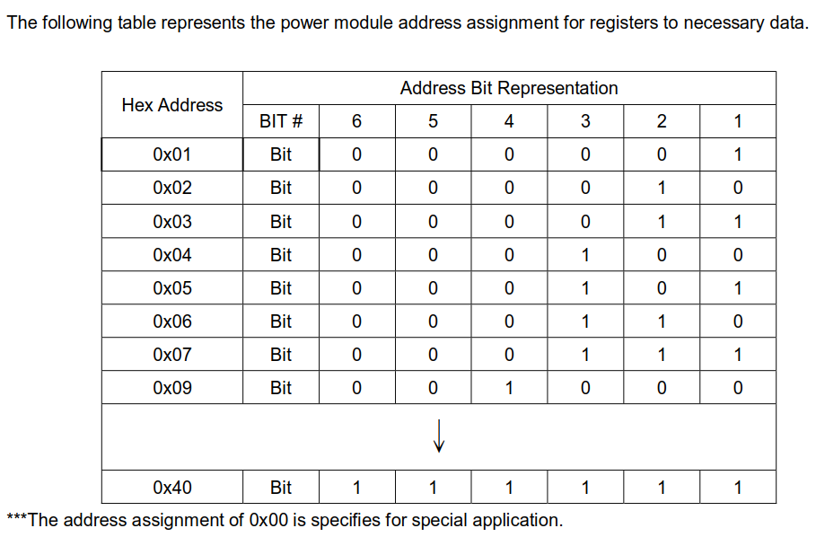
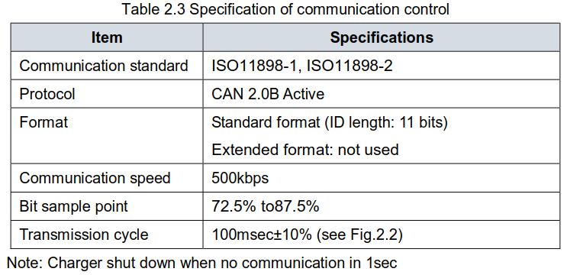
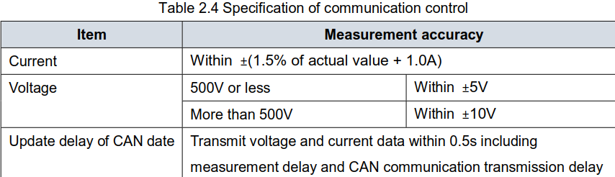
Secondary MCU – Peripheral Config. & Logics
Communications:
CAN Bus:

Slide 19
Secondary MCU - Control Block Diagram - New
+800V
LLC 1 & LLC 2
HVDC+
BAT+
LLC1
550V
ILLC12
3 Ph AC I/P ~323-553Vac
HVDC V & I Sense
EMI & Oring
VBAT Sense
LLC2
550V
HVDC-
BAT-
LLC 3 & LLC 4
LLC3
550V
ILLC34
IHVDC
VHVDC
I2
VHVDC
VBAT_SEN
-800V
LLC4
550V
I34
ILLC1
ILLC2
VLLC1
VLLC2
VLLC3
VLLC4
ILLC3
ILLC4
LLC & BUCK V & I Sensing
VLLC1 to 4 - 4 Channels
VBUCK1 & 3 - 2 Channels
IBUCK1 & 3 - 2 Channels
V&I HVDC – 2 Channels
VBAT Sense – 1 Channel
8A/B
6A/B
3A/B
2A/B
PWM DRIVER
Additional Analog Sensing
Total 12 Channels
VAUX – 1 Ch
NTC Thermistor – 11 Ch
(Out of 11, 3 Channels are connected Directly and 8 Channels are connected through an Analog Mux).
ILLC1-4
PWM Outputs
LLC OCP
OVP/OCP/ SCP
TI
TMS320F28069
BUCK OVP
VBUCK1-4
Analog IN
TZ Inputs
HVDC OCP
IHVDC
Discharge EN
To VOUT Discharge Control
Mux Sel. 1-3
DO
DO
DI’s
6 Bit Address
CAN Addr. Selection
From Dip Switch
PFC EN
DO
DI
D2D EN
AC OK & PFC OK
DI
TX
To/From System
Output
Connector
RX
PWM
Output
CAN
CAN Bus Driver
UART
RX
TX
I2C Master
DO
DI
PWM Output
To/From Primary MCU
4A
3 FAN Speed Inputs
Analog Input
CLOCK
DATA
Digital Input
FAN DRIVER
To FAN
Digital Output
I2C EEPROM M24256-BWDW6TP
3 LED
Control Pins
COM (I2C/UART/SPI/CAN)
LED DRIVER
TZ Input
For Calibration/
Config Data
To LED’s

Slide 20
Secondary MCU – Peripheral Config. & Logics
PWM Trip Zone(TZ) Inputs – For Protection:
BUCK OVP TZ (Active LOW)
HW OVP @ 575V on any Buck O/P with Ref set @ 2,911V
BUCK OCP TZ (Active LOW)
HW Buck OCP @ 99A on Buck1 or 3 O/P with Ref set @ 1.65V
LLC OCP TZ (Active LOW)
HW LLC OCP @ 30APk(60A) on LLC Primary Side @ 1.65V
PWM Outputs:
FAN PWM: (H) 4A
Fan Model - V12E12BS1B5
Config – Independent PWM Mode
Frequency & Fan Control Algorithm – To Be Defined.
LLC1 DRA, DRB, DRC & DRD – Open Loop
Config – Complementary PWM Mode
Frequency – 100KHz
Duty % - 50% Duty
LLC2 DRA, DRB, DRC & DRD – Open Loop
Config – Complementary PWM Mode
Frequency Range – 100KHz
Duty % - 50% Duty

Slide 21
Secondary MCU – Peripheral Config. & Logics
PWM Outputs:
Buck1 DRA, DRB & Buck2 DRA, DRB : (Closed Loop)
Control Algorithm:
Frequency Range – 45KHz
Config – Complementary PWM Mode
Controller Type 2P1Z

Slide 22
Secondary MCU – Peripheral Config. & Logics
Interrupts:
ADC Interrupt – 20KHz, High Priority, For Main Buck Control Loop.
1mS Timer Interrupt – for LLC Open Loop Control.
PWM Trip Zone Interrupt – High Priority for Protections.
CAN Bus Interrupt for Rx & Tx - Medium Priority , Minimal execution time.
UART RX and TX Interrupts – Medium Priority , Minimal execution time.
Other Timer Interrupt – 100uS (for Main Task Handler), Low Priority
I2C Master Interrupt – Low priority, called only during startup, Loading EEPROM data and during saving calibration data.

Slide 23
Clarification required &
Support needed

Slide 24
Queries for Clarification
Is “Vienna rectifier” uses, Space Vector PWM control (SVPWM) ? Or? Yes SVPWM
Are you using/having any plant model or Model based design files for Vienna rectifier?
Are you using/having any plant model or Model based design files for LLC/Buck Converter?
Is our understanding on Interrupts/peripheral configs for primary MCU are correct?
Control Loop interrupt is triggered by Timer ? Or PWM? Or ADC? ADC
Are we missing any interrupts @ Primary MCU?
What is the compensator type (2p2z, 3p3z) used for ?
Vienna – Normal PI
LLC - Open Loop
Buck - 2P1Z
Is there any document for the FW, to understand the requirements of delays/thresholds for Relay/PFC Turn ON/OFF, CAN bus commands, UART data/commands etc..
Is any specific CAN Bus Specification (Req. commands/data & address to implement) available for this project? if so can share the document.
.

Slide 25
Support / Document needed from HQ
Is HQ works with Model Based Design (MBD) for control Loop design? With MATLAB/Simulink or PSIM? If so, can share
Any document on MBD procedure.
Any training material for MBD? Mainly for control algorithm/Loop Design.
Any model-based design files used for this project. (for Vienna or LLC).
For our better understanding on the FW implementation, can HQ provide us with the below documents/details of this project?
Control Algorithm and its implementation details for Vienna Rectifier & LLC/Buck Converter.
Any document on TI’s “CLA” usage with this project in both primary and secondary MCU’s.
Access to Project Source code (For Control Loop ISR and Configs) for both Primary & Secondary MCU’s. (Mainly to understand the peripheral Configuration and Control loop, CLA implementation in TI MCU’s).
Any other document with details on Fault protection trigger and recovery mechanism. (OVP, OCP, OTP, Input Fail etc..)
CAN Bus documents specific to this project/to EV Chargers to understand its requirements.
Preliminary CAN bus spec. provided

Slide 26
Thanks CES SG Understanding & Clarifications

